Slide 1
APR Auto Refresh Workflow
Claire Kraft

Slide 2
Locates Models

Slide 3
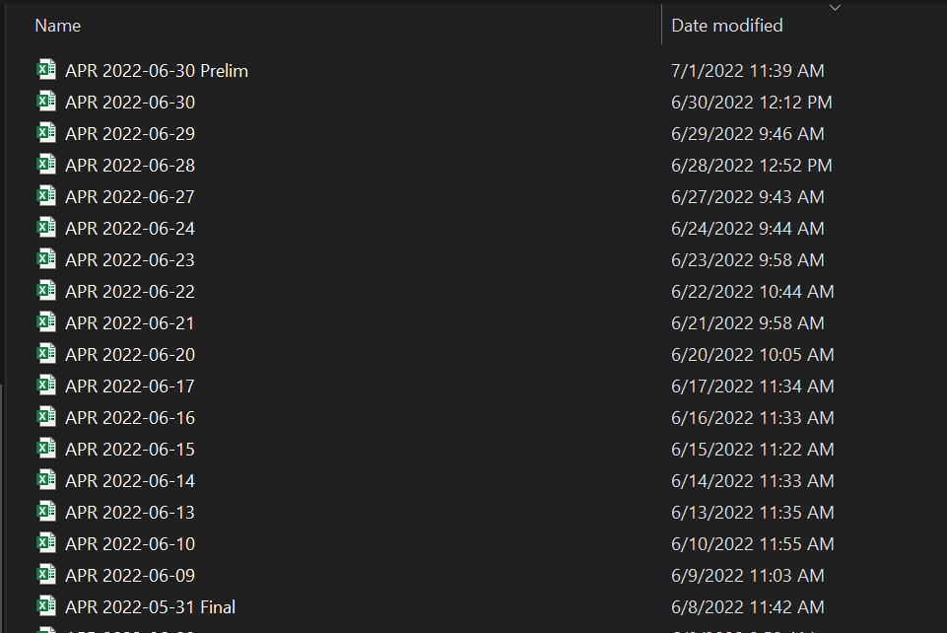
APR Models Timestamped

Slide 4
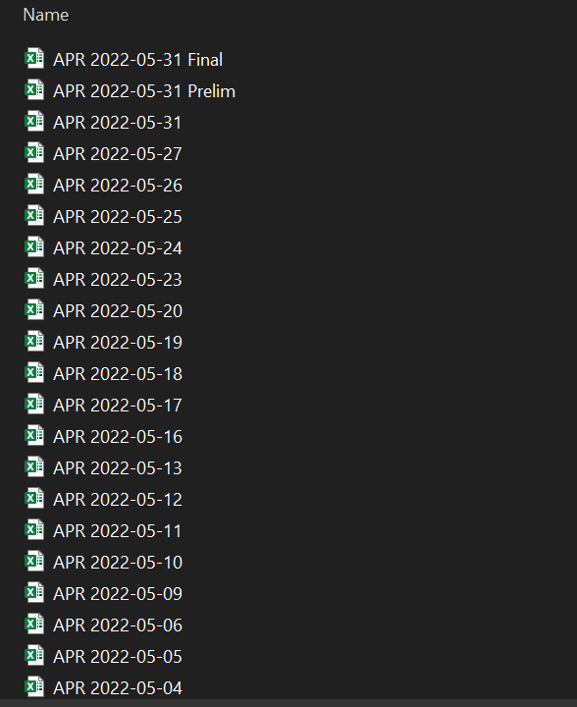
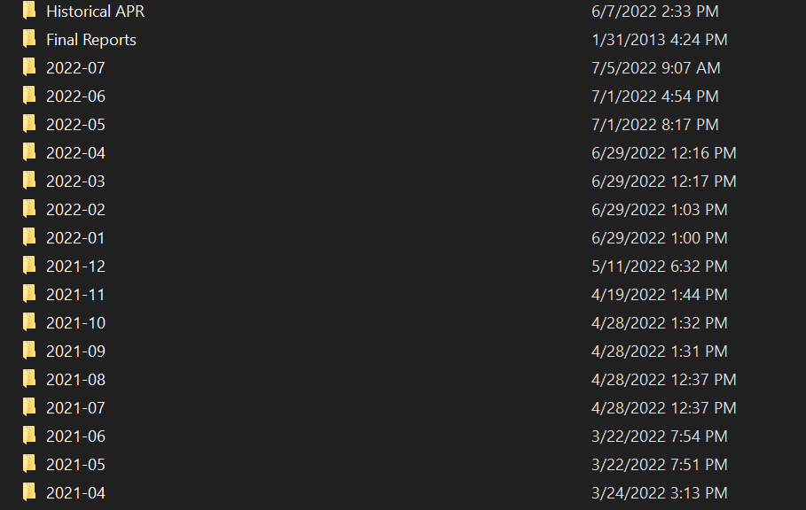
APR Published (Internal)

Slide 5
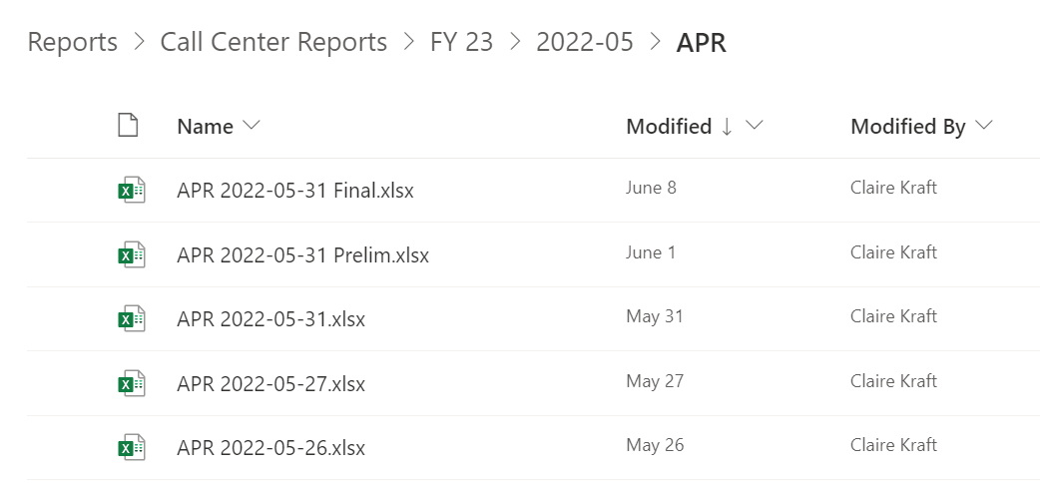
APR Published (External)

